Slide 1
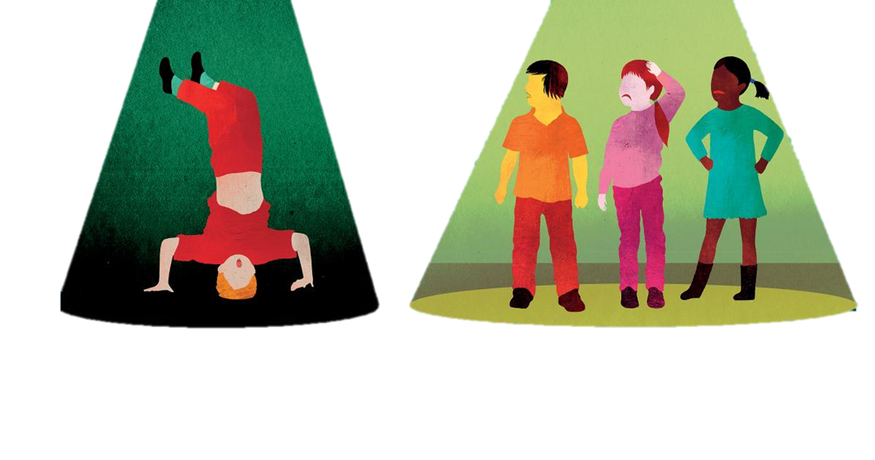
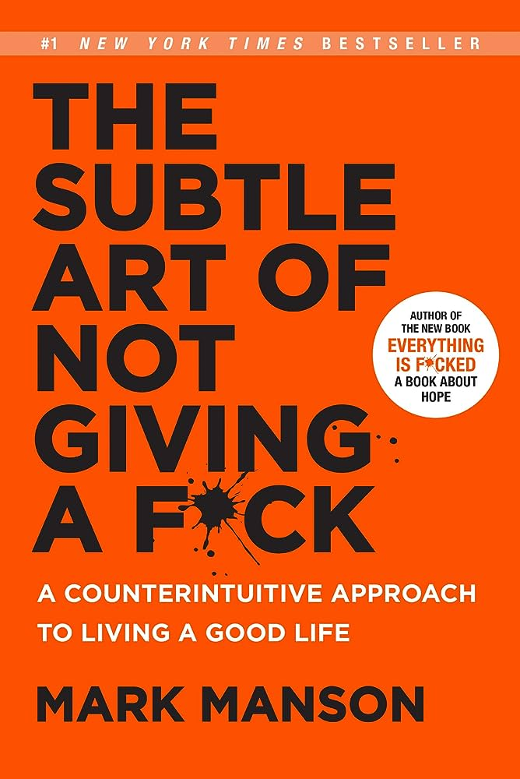
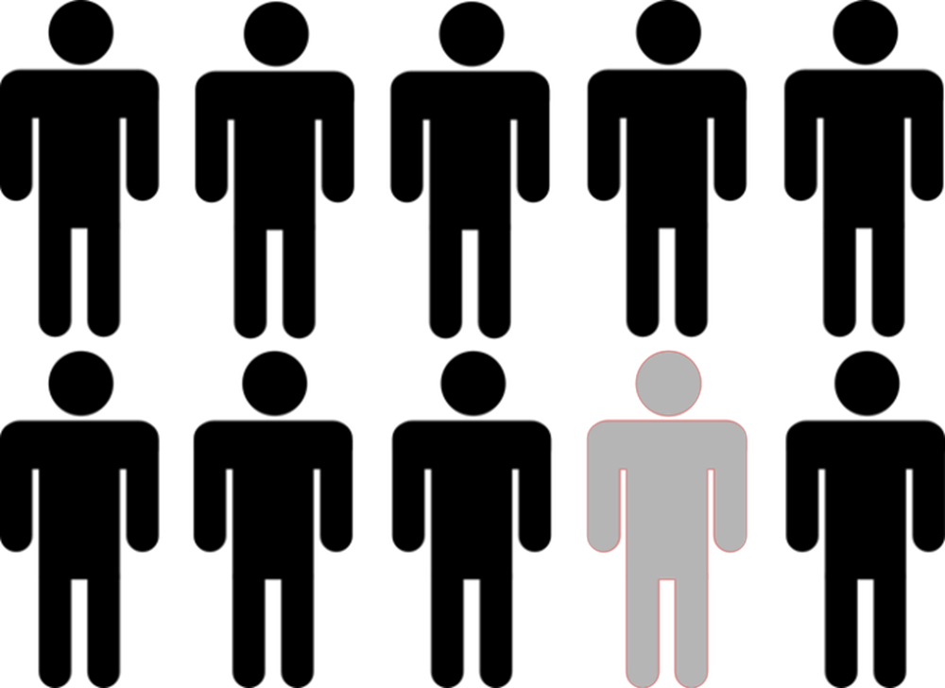
When to be honest?
Visual Analytics Topic Proposal - Daniel Stulberg Huf
“Your mom told you to be yourself. That’s easier said than done”.
Social
Conformity
Radical
Honesty

Slide 2
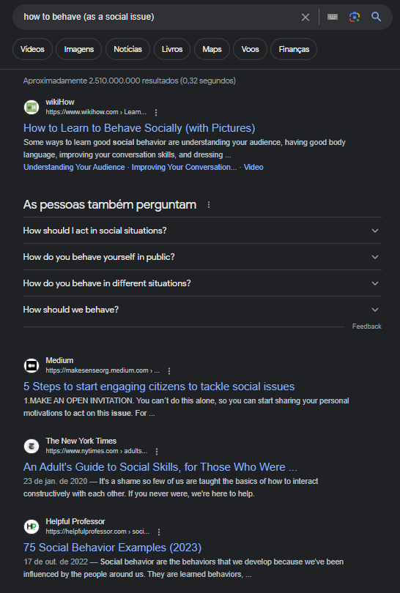


The impact of our honesty on society (and in ourselves).
Research suggests that happy people are often assumed to be pushovers and naive [1].
White lies vs. antisocial lying [2] “Without lies, marriages would crumble, workers would be fired, governments would collapse” [3].
The impact of social media in shaping people’s honesty (and conversely) [4].
Context matters!

Slide 3
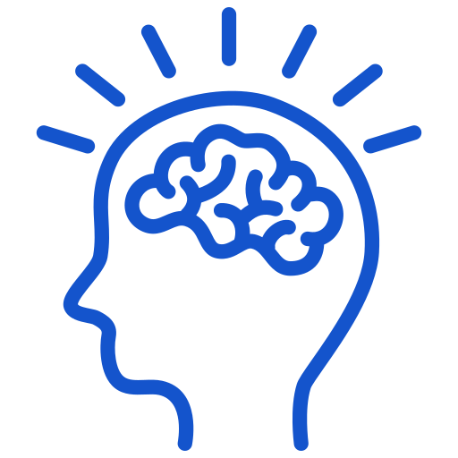
Personal thoughts
Ethical considerations
The morality of lying?
The impact of honesty on trust?
How to differ one’s behavior virtually and in the real world?
Individual vs. Collective perspectives
How to identify a genuine individual decision rather than a collective societal trend when analyzing one’s behavior?
Interdisciplinary collaboration
How to merge data analysis and visualization with the psychology, sociology, and ethics of honesty?

